Slide 1
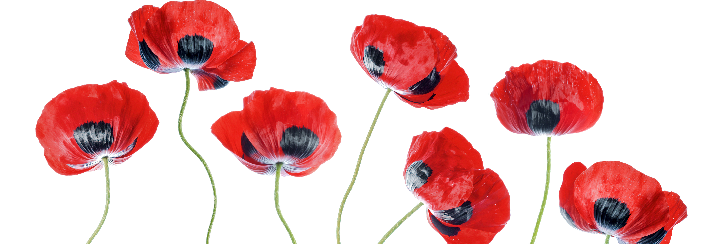
Remembrance Day 2021
We will remember

Slide 2
AGENDA
“A Pittance of Time”
O Canada (Clip: CAF Military Bands)
What does remembering our veterans mean? (Clip: Click on image - CAF speakers discuss)
In Flander’s Fields/Au champ d’honneur (Read with your child)
Last Post (Clip: The Stadacona Band of the Royal Canadian Navy)
2 minutes of silence
The Rouse (Clip: The Stadacona Band of the Royal Canadian Navy)
“Highway of Heroes” (Clip: The Trews)
God Save the Queen (Clip: Song)
Student contributions (Gr. 5 LaCosta)
Thank-you message

Slide 3
A Pittance of Time

Slide 4
O CANADA
CAF MILITARY BANDS

Slide 5
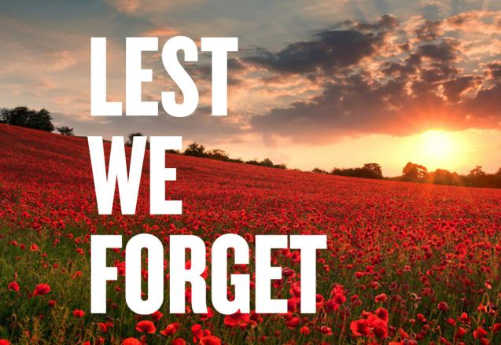
What does remembering our veterans mean?
CAF speakers deliver messages about Veterans’ Week/Remembrance Day

Slide 8
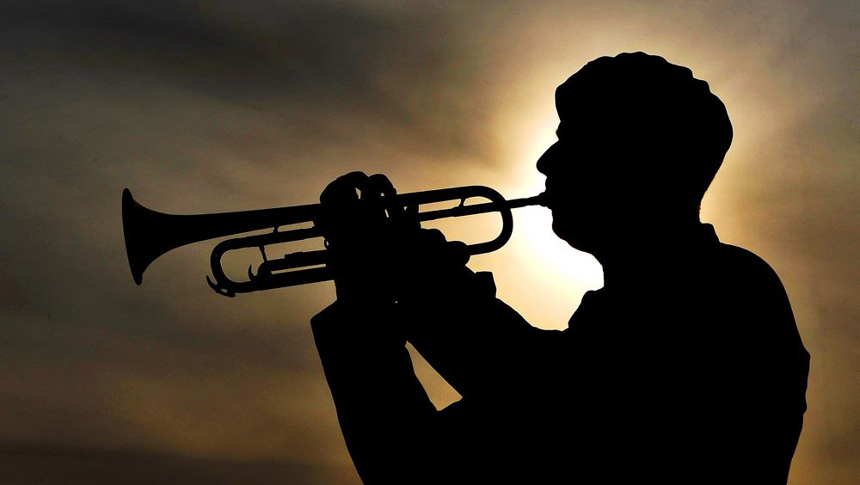
LAST POST
Folllowed by 2 minutes of silence

Slide 9
THE ROUSE

Slide 10
HIGHWAY OF HEROES

Slide 11
GOD SAVE THE QUEEN

Slide 12
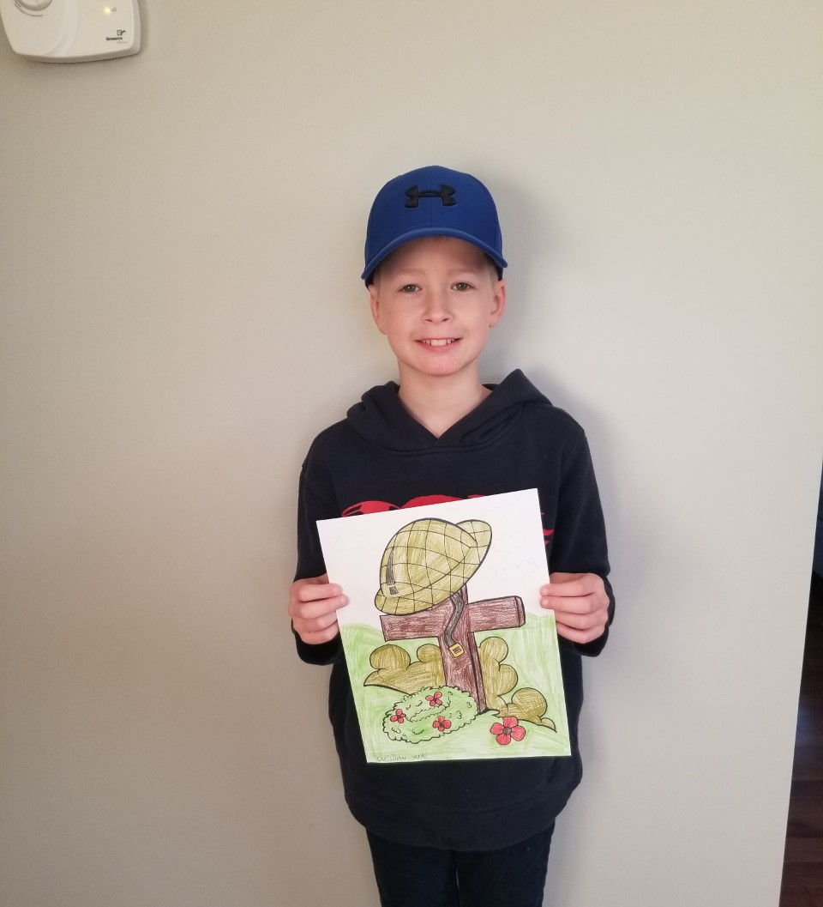
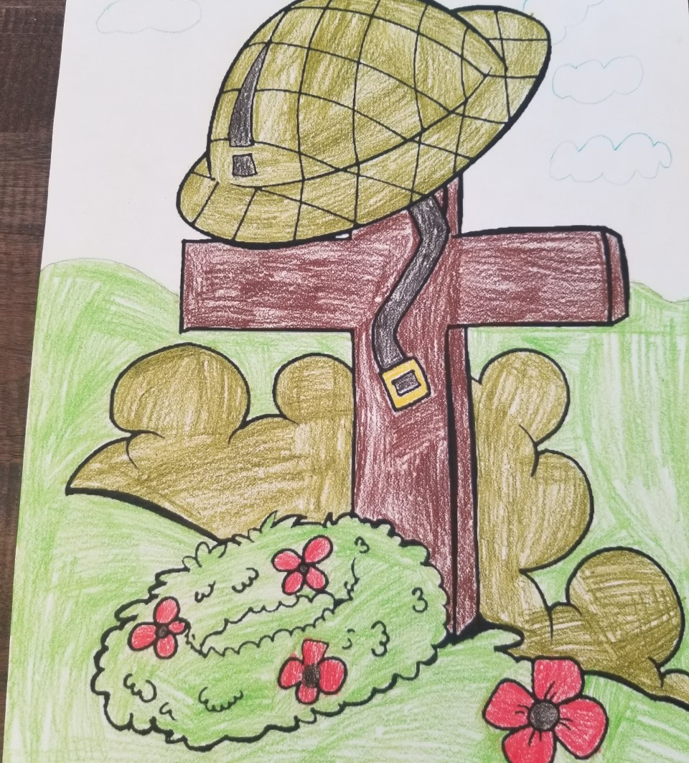

Slide 13
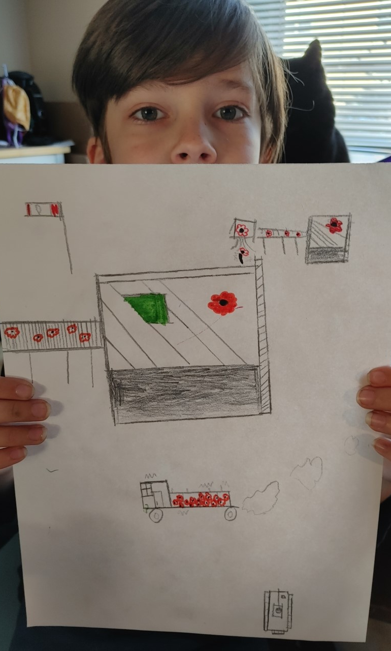
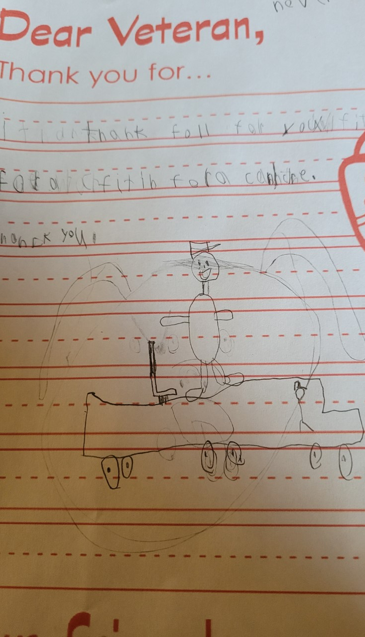

Slide 14
Thank You
The Remembrance Day Ceremony has played a significant role in Canada since 1931. The staff of Nashwaaksis Memorial School would like to thank you for taking the time to honour those who currently serve and those who have served our country.
The Act of Remembrance
They shall grow not old, as we that are left grow old
Age shall not weary them, nor the years condemn
At the going down of the sun and in the morning
We will remember them.
We will remember them.

